Slide 1


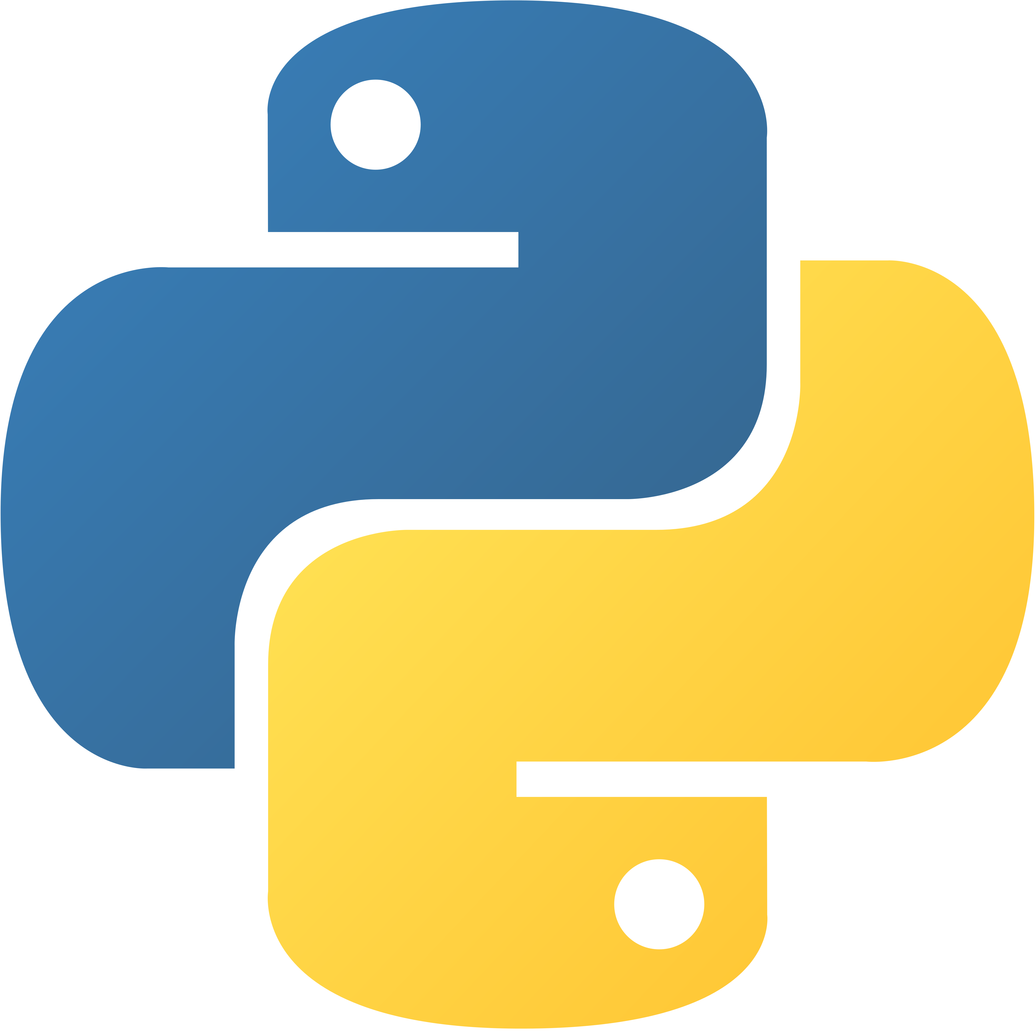



LEARNING PYTHON
沈愛希
LEARNING
PYTHON
SHANE ASHLY
G. BIRAD
20221005

Slide 2

OBJECTIVE:
Learning Pythons
Input and Output
Data Types
Operators

Slide 3

CONTENT
What is Python?
Python Jobs
Why to Learn Python
Python Online Interpreter
One
Two
Google Colab
Python Codes

Slide 4

Python is an interpreted, object-oriented, high-level programming language with dynamic semantics developed by Guido van Rossum and originally released in 1991. Python is dynamically-typed and garbage-collected. It is supports multiple programming paradigms, including structured, object-oriented and functional programming.
What is Python

Slide 5
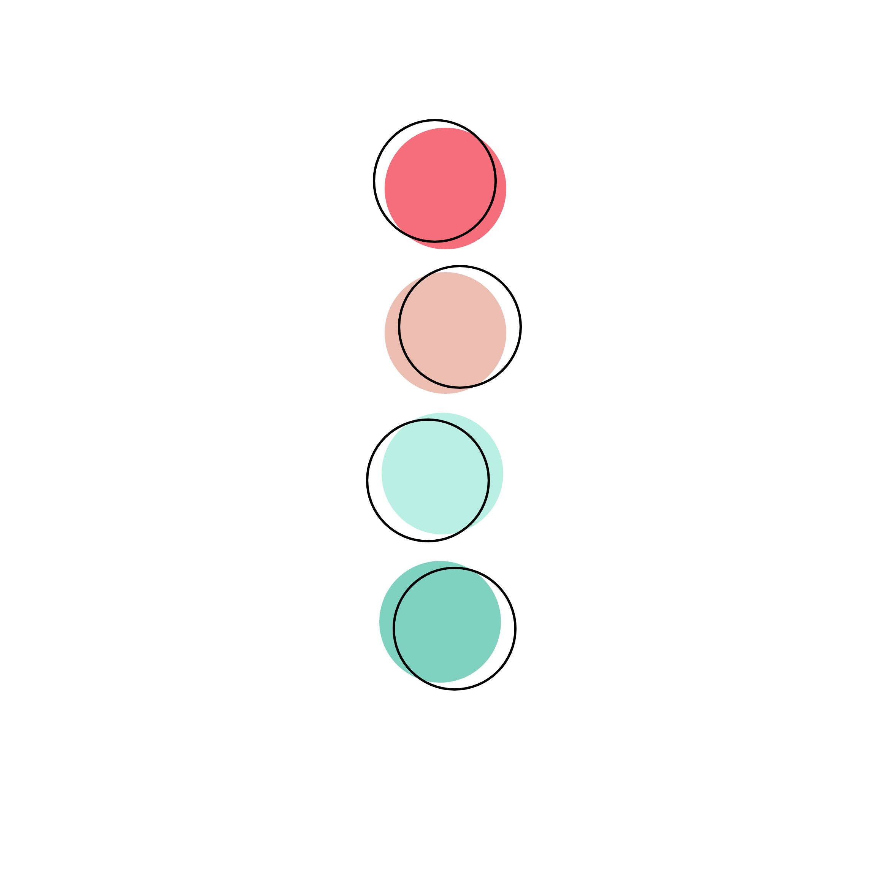






Python Jobs
Python is not only one of the most popular programming languages across the globe, but it is one that offers the most promising career opportunities as well. This demand for Python developers is increasing every year. There is a reason why this high-level programming language is so popular.
There are big companies that uses python programming language such as
Pinterest
Facebook
Youtube
Google
Netflix

Slide 6

Why to Learn Python
Python is a very popular programming language today and often needs an introduction. It is widely used in various business sectors, such as programming, web development, machine learning, and data science.
Python is a general-purpose, versatile and popular programming language. It’s great as a first language because it is concise and easy to read, and it is also a good language to have in any programmer’s stack as it can be used for everything from web development to software development and scientific applications.

Slide 7

Why to Learn Python
5 Top Reasons to Learn Python
1. Python is the Easiest Programming Language To Learn
2. Python is the Most Versatile Coding Language
3. Learning Python will Improve Your Job Prospects
4. You can Earn a Competitive Salary Working as a Python Developer
5. Become Part of a Supportive Python Community

Slide 8

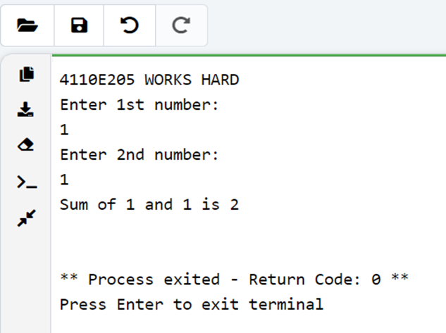
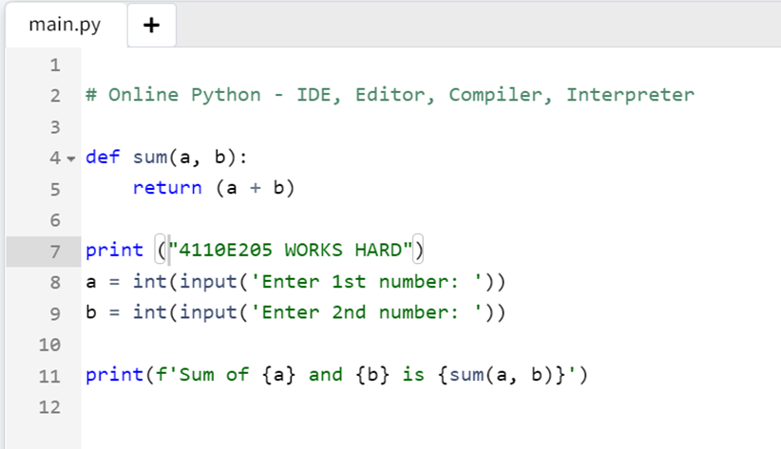
Python Online Interpreter 1

Slide 9

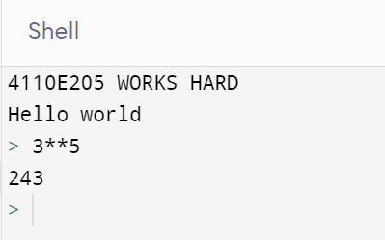
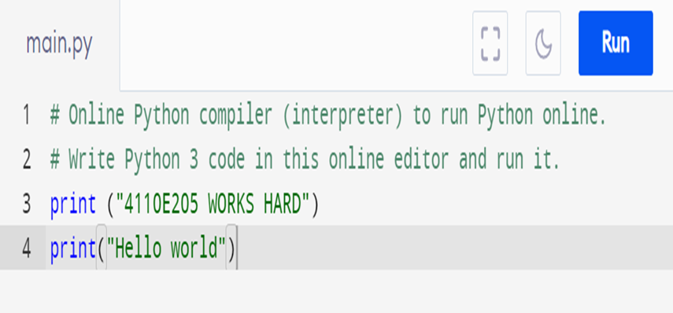
Python Online Interpreter 2
I
INTERACTIVE

Slide 10


INPUT AND OUTPUT
20221005

Slide 11
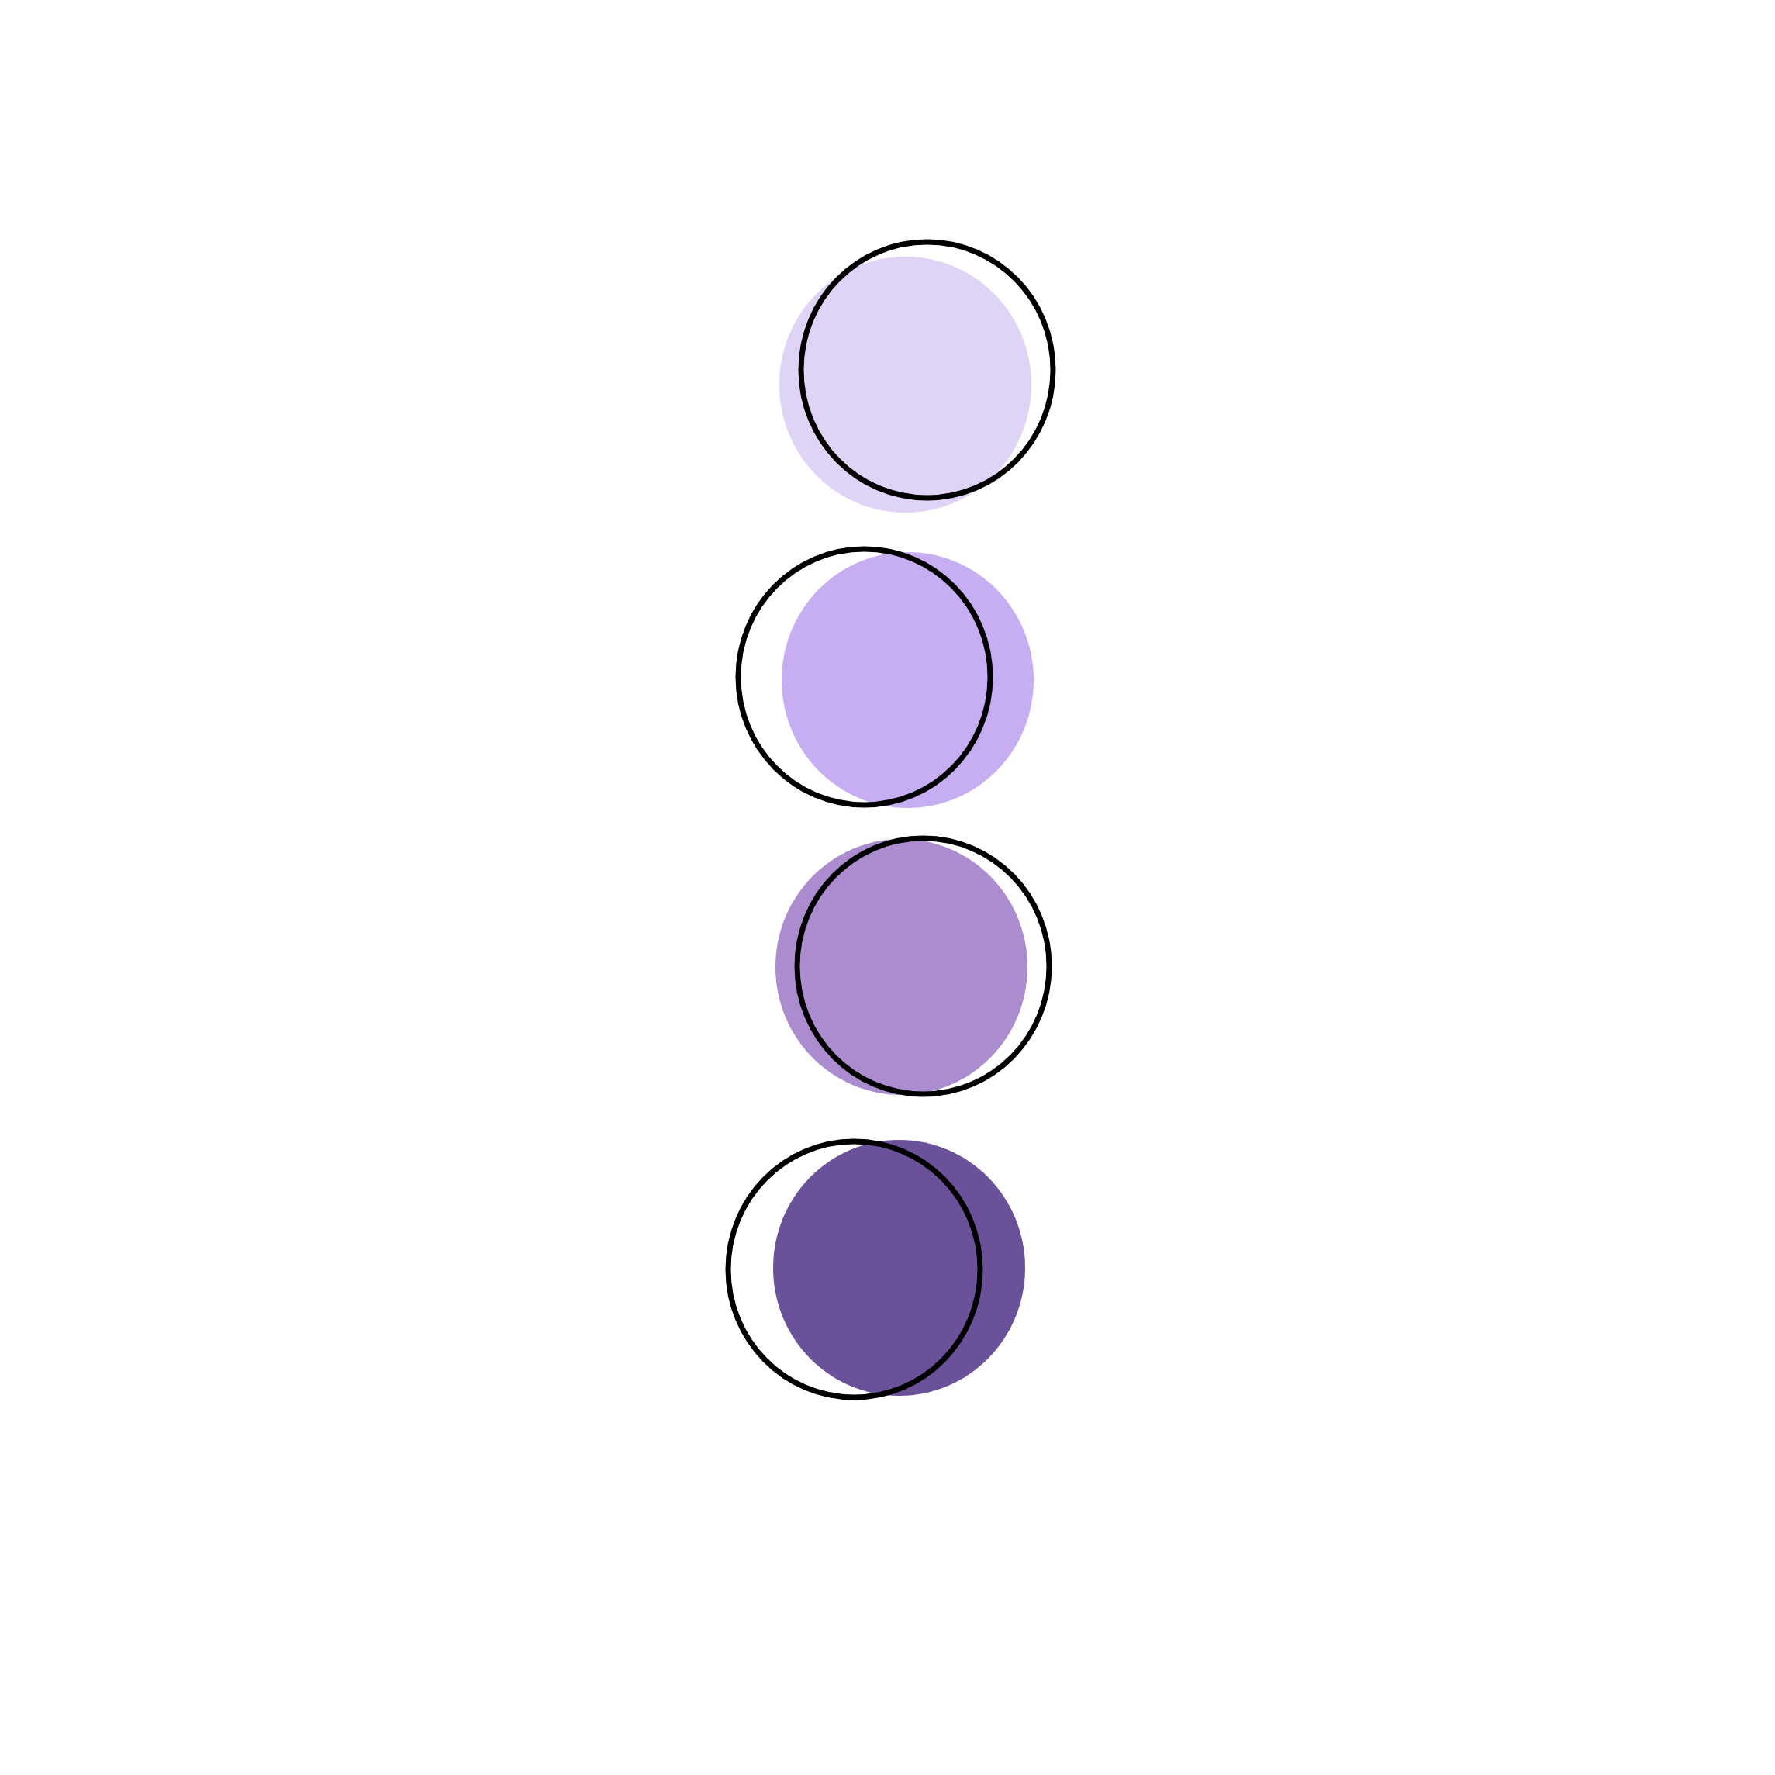
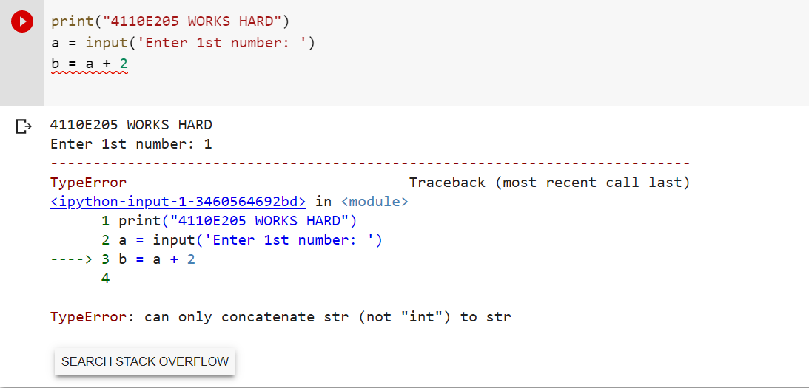
QUESTION:
DATA TYPE

Slide 12
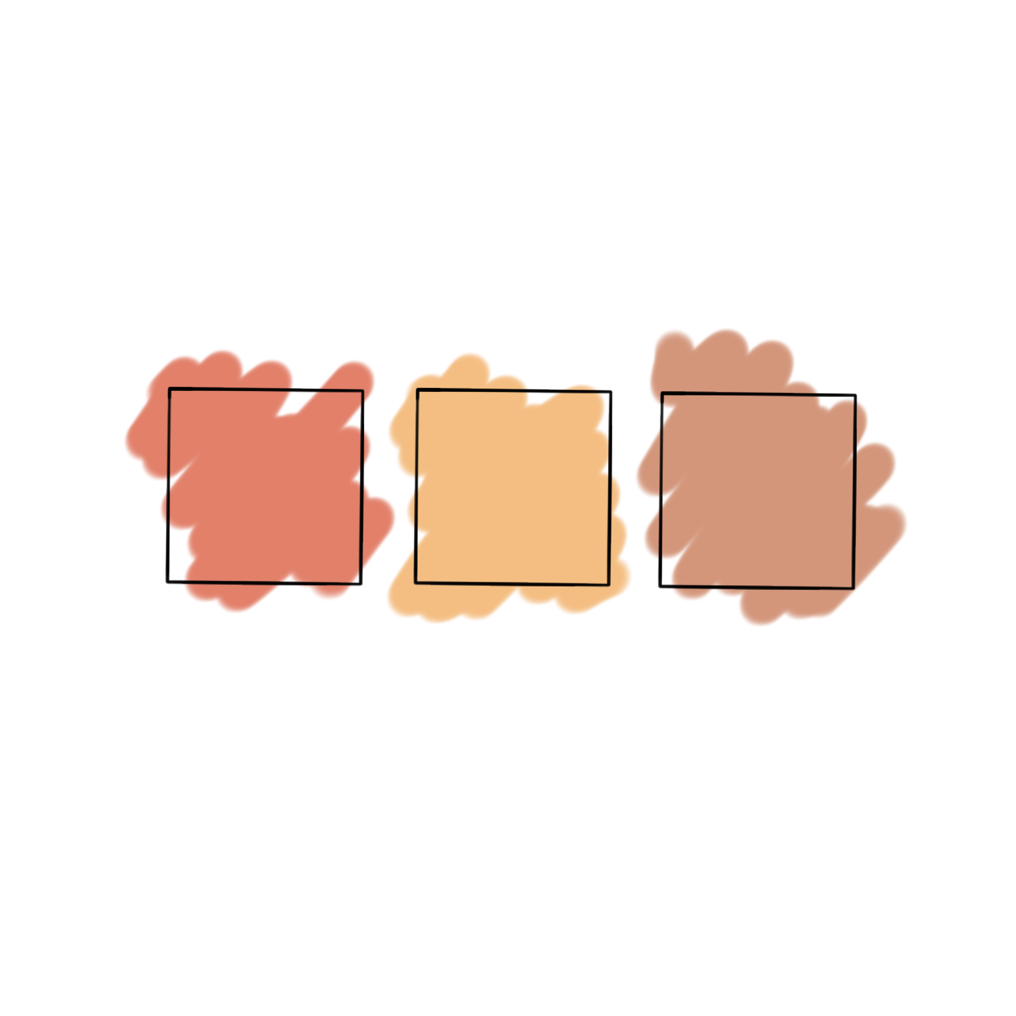
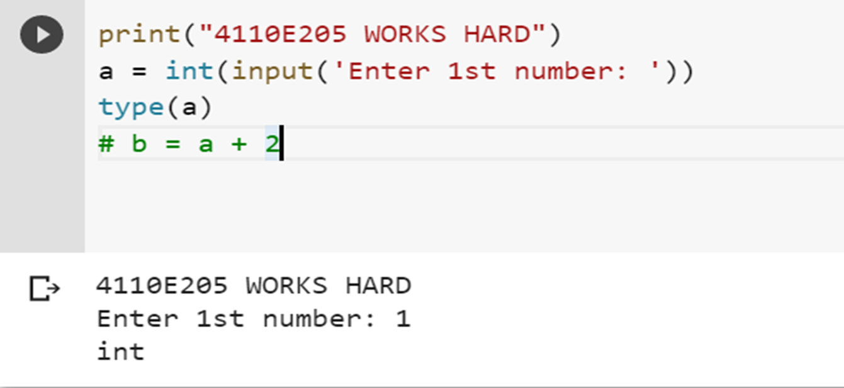
WAY 1:

Slide 13

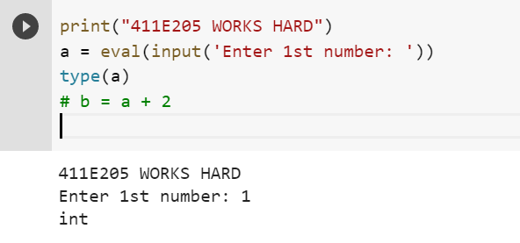
WAY 2:

Slide 14
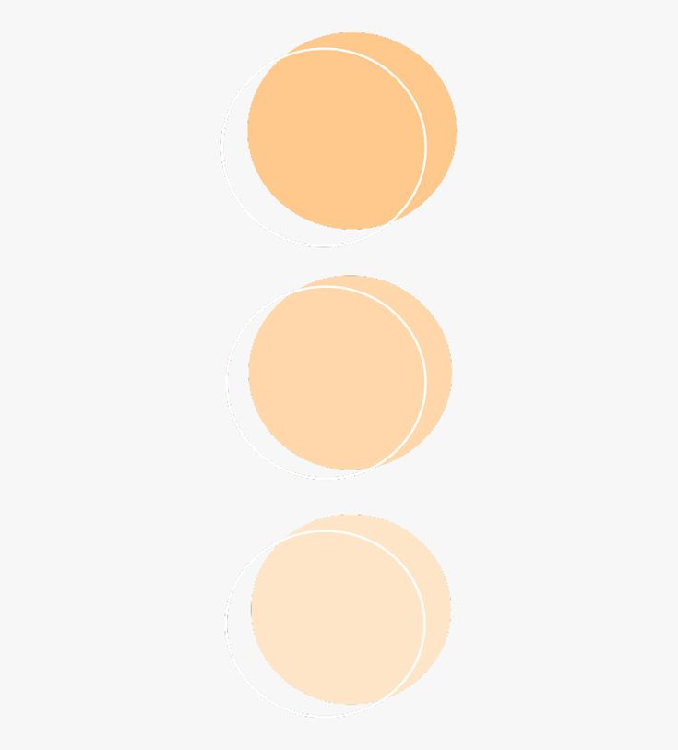
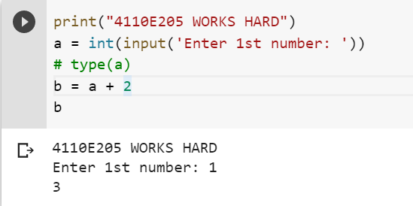
ANSWER 1:

Slide 15

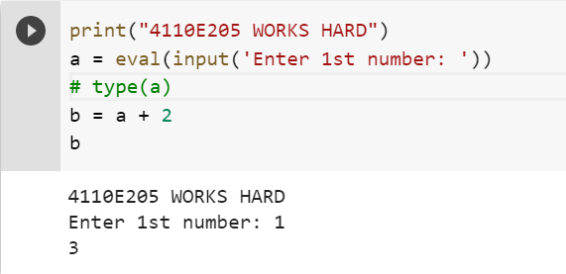
ANSWER 2:

Slide 16

PYTHON DATA
TYPES
20221005

Slide 17
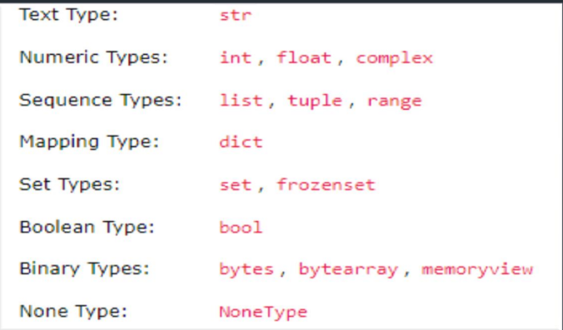

DATA TYPES
In programming, data type is an important concept.
Variables can store data of different types, and different types can do different things.
Python has the following data types built-in by default, in these categories:

Slide 18


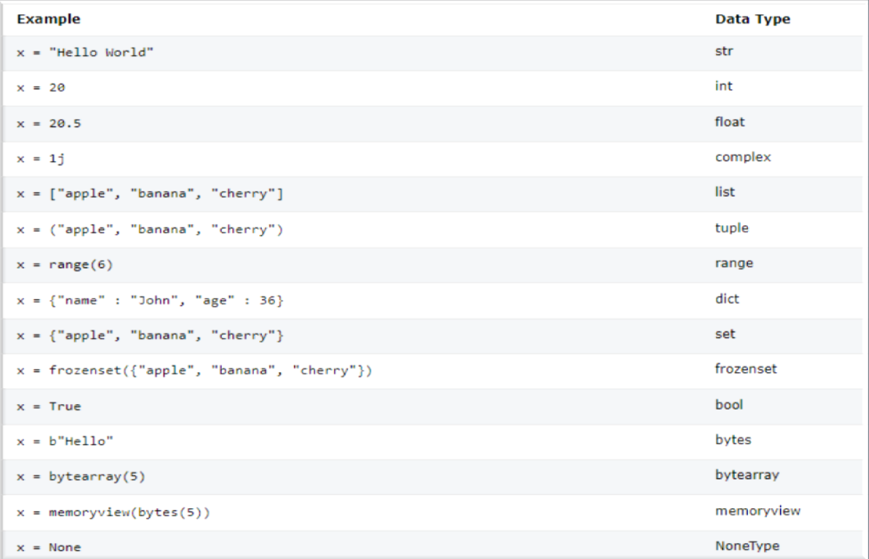
SETTING THE SPECIFIC DATA

Slide 19


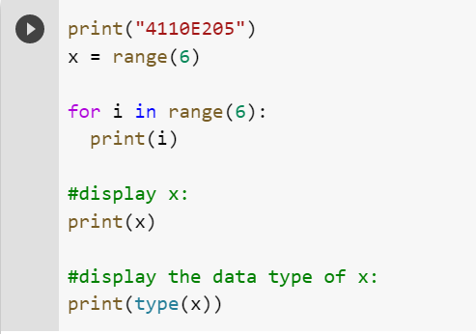
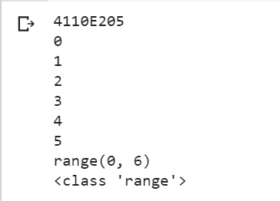
PYTHON DATA

Slide 20

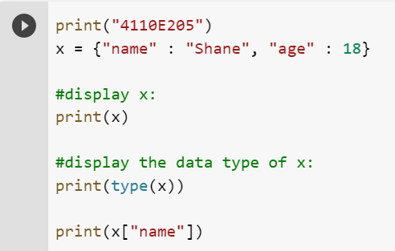
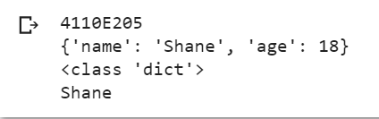
DICT: KEY VALUE PAIR

Slide 21

PYTHON OPERATORS
20221005

Slide 22


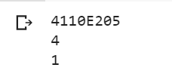
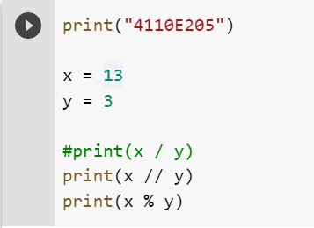

PYTHON ARITHMETIC
OPERATORS

Slide 23
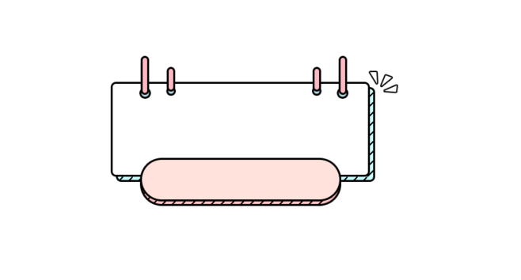

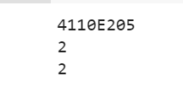
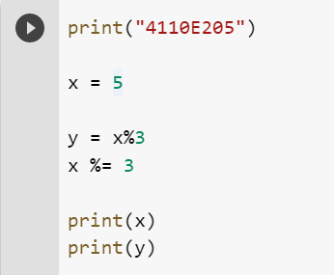

PYTHON ASSIGNMENT
OPERATORS

Slide 24


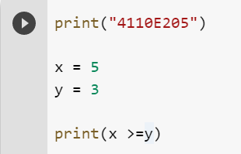
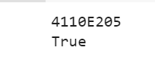
PYTHON COMPARISON OPERATORS

Slide 25


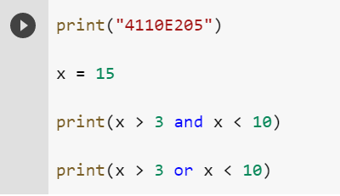
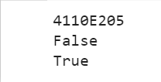
PYTHON LOGICAL
OPERATORS

Slide 26


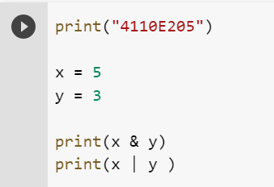
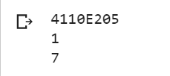
PYTHON BITEWISE OPERATORS

Slide 27

CHINESE NAME: 沈愛希 STUDENT ID: 4110E205 ENGLISH NAME: Shane Ashly G. Birad NICKNAME: Shane Email: biradshane@gmail.com GITHUB: https://github.com/4110E205/cs2022.git

